Slide 1

ICT-4257: Cryptography and Network Security
for
4th Year 2nd Semester of B.Sc (Honors) in ICT
Lecture File: 08
DES & RSA Cryptosystems
Prepared by:
Professor K M Akkas Ali
akkas@juniv.edu, akkas_khan@yahoo.com
Institute of Information Technology (IIT)
Jahangirnagar University, Dhaka-1342

Slide 2
Lecture File: 08
DES & RSA Cryptosystems
Topics to be Discussed
To introduce modern block ciphers and their characteristics
To introduce the components of modern block ciphers
To discuss product ciphers and discuss between Feistel and non-Feistel ciphers
To review a short history of DES
To define the basic structure of DES
To describe the details of building elements of DES
To describe the round keys generation process
To analyze DES
To discuss the RSA cryptosystem

Slide 3
Modern Symmetric-key Ciphers:
Character-oriented Vs. Bit-oriented Ciphers:
The traditional symmetric-key ciphers are character-oriented ciphers.
Now-a-days, the information to be encrypted is not just text; it can also consist of numbers, graphics, audio, and video data. It is convenient to convert these types of data into a stream of bits, to encrypt the stream, and then to send the encrypted stream.
So, we need bit-oriented ciphers.
When data is treated as the collection of bits, it becomes larger. Mixing a larger number of symbols increases security.
Kinds of Modern Symmetric-key Ciphers:
Modern symmetric-key ciphers can be divided into two broad categories:
Stream ciphers:
Stream cipher encrypts a single character or bit of plaintext at a time. It also decrypts a single character or bit of ciphertext at a time.
Block ciphers:
A symmetric-key modern block cipher encrypts an n-bit block of plaintext or decrypts an n-bit block of ciphertext together.

Slide 4
Stream Ciphers (continued…)
Example:
Given plaintext: 10011011110100001 Let the keystream be a stream of 1s and 0s.
If we use an exclusive or (XOR) with the keystream and plaintext, we get ciphertext.
This keystream is called periodic, since the sequence '10' repeats over and over.
Plaintext : 10011011110100001 Keystream : 10101010101010101 Ciphertext : 00110001011110100 (by XORing each plaintext bit with corresponding keystream bit)
To decrypt this ciphertext, all we need to do is again XOR the ciphertext with the keystream:
Ciphertext : 00110001011110100 Keystream : 10101010101010101 Plaintext (XOR) : 10011011110100001
Notes:
4

Slide 5
Block Ciphers:
Example
Plaintext : The only thing we have to fear is fear itself
Modified plaintext : Theonlythingwehavetofearisfearitself
Plaintext blocks : Theonlyt hingweha vetofear isfearit selfXend (break the plaintext into 8-character block)
Ciphertext blocks : tylnoehT ahewgnih raefotev tiraefsi dneXfles (just reverse each plaintext block)
Ciphertext : tylnoehTahewgnihraefotevtiraefsidneXfles

Slide 6
Components of a Modern Block Ciphers:
Modern block ciphers normally are keyed substitution ciphers in which the key allows only partial mappings from the possible inputs to the possible outputs.
However, modern block ciphers normally are not designed as a single unit.
To provide the required properties of a modern block cipher, such as diffusion and confusion, a modern block cipher is made of a combination of several units:
Transposition units (called P-boxes)
Substitution units (called S-boxes)
Some other units
Notes:
6

Slide 7
Components of a Modern Block Ciphers (continued…):
P-Boxes:
A P-box (permutation box) is a component in a modern block cipher that transposes bits.
Types of P-Boxes:
Three types of P-boxes are used in modern block ciphers:
Straight P-Boxes
Expansion P-Boxes
Compression P-Boxes
Notes:
7

Slide 8
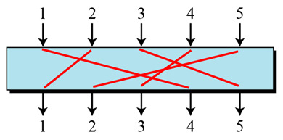
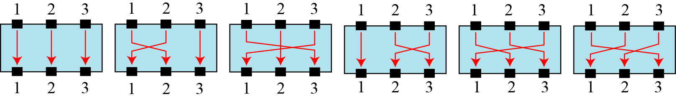
Components of a Modern Block Ciphers (continued…):
Straight P-Boxes:
A straight P-Box is a permutation which has n inputs and n outputs.
There are n! possible mappings.
Figure below shows a 5 x 5 straight P-box.
Figure: A 5x5 straight P-box
Example of all mappings for Straight P-Boxes:
Figure below shows a 3x3 straight P-box with all 6 (3!) possible mappings.
Figure: The possible mappings of a 3 × 3 Straight P-box
Notes:
8

Slide 9
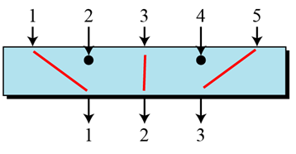
Components of a Modern Block Ciphers (continued…):
Compression P-Boxes:
A compression P-box is a P-box with n inputs and m outputs where m<n.
Some of the inputs are blocked and do not reach the output.
Figure below shows a 5 x 3 compression P-box.
Figure: A 5x3 Compression P-box
The compression P-boxes used in modem block ciphers are keyless normally, where a permutation table shows the rules for transposing bits.
Compression P-boxes are used when we need to permute bits and the same time decrease the number of bits for the next stage of encryption/decryption.
Notes:
9

Slide 10
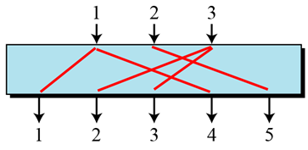
Components of a Modern Block Ciphers (continued…):
Expansion P-Boxes:
A expansion P-box is a P-box with n inputs and m outputs where m>n.
Some of the inputs are connected to more than one output.
Figure below shows a 3 x 5 expansion P-box.
Figure: A 3 x 5 Expansion P-box
The expansion P-boxes used in modem block ciphers normally are keyless, where a permutation table shows the rules for transposing bits.
Expansion P-boxes are used when we need to permute bits and the same time increase the number of bits for the next stage of encryption/decryption.
Notes:
10

Slide 11
Components of a Modern Block Ciphers (continued…):
S-Boxes:
An S-box (substitution box) can be thought of as a miniature substitution cipher.
However, an S-box can have a different number of inputs and outputs. In other words, the input to an S-box could be an n-bit word, but the output can be an m-bit word, where m and n are not necessarily the same.
Although an S-box can be keyed or keyless, modem block ciphers normally use keyless S-boxes, where the mapping from the inputs to the outputs is predetermined.
Notes:
11

Slide 12
Components of a Modern Block Ciphers (continued…):
Input-Output Relationship for a 3x2 S-Box by Table:
The following table defines the input/output relationship for an S-box of size 3 × 2.
The leftmost bit of the input defines the row; the two rightmost bits of the input define the column.
The two output bits are values on the cross section of the selected row and column.
Table: Input-Output relationship for a 3 x 2 S-box
Based on the above S-box table, an input of 010 yields the output 01. An input of 101 yields the output of 00.
Notes:
12

Slide 13
Components of a Modern Block Ciphers (continued…):
Kinds of Product Ciphers:
Modern block ciphers are all product ciphers, but they are divided into two classes:
Feistel ciphers
Non-Feistel ciphers
Feistel ciphers:
In 1973, Feistel designed a very intelligent and interesting cipher that has been used for decades. Several block ciphers are based on the Feistel structure.
This type of ciphers use both invertible and noninvertible components.
A Feistel cipher can have three types of components: self-invertible, invertible, and noninvertible.
A Feistel cipher combines all noninvertible elements in a unit (called mixer) and uses the same unit in the encryption and decryption algorithms.
The block cipher DES, IDEA, RC5 (Rivest’s Cipher) are good examples of a Feistel cipher. But Feistel design is not used in AES.
Notes:
13

Slide 14
Components of a Modern Block Ciphers (continued…):
Non-Feistel ciphers:
This type of ciphers use only invertible components.
A component in the encryption cipher has the corresponding component in the decryption cipher.
For example, S-boxes need to have an equal number of inputs and outputs to be compatible. No compression or expansion P-boxes are allowed, because they are not invertible.
In a non-Feistel cipher, there is no need to divide the plaintext into two halves as we saw in the Feistel ciphers.
The block cipher AES is a good example of a non-Feistel cipher.
Notes:
14

Slide 15
Confusion and Diffusion:
The terms diffusion and confusion were introduced by Claude Shannon to capture the two basic building blocks for product cipher.
Every block cipher involves a transformation of a block of plaintext into a block of ciphertext, where the transformation depends on the key.
Hence, the block cipher needs to completely obscure statistical properties of original message.
Shannon suggested combining S & P elements to obtain diffusion and confusion.
Diffusion:
The idea of diffusion is to hide the relationship between the ciphertext and the plaintext. That is, the statistical relationship between the plaintext and ciphertext is made as complex as possible in order to thwart attempts to deduce the key. This will frustrate the adversary who uses ciphertext statistics to find the plaintext.
Diffusion implies that each symbol (bit) in the ciphertext is dependent on some or all symbols in the plaintext. In other words, if a single symbol in the plaintext is changed, several or all symbols in the ciphertext will also be changed.
Confusion:
The idea of confusion is to hide the relationship between the ciphertext and the key. That is, the relationship between the ciphertext and the key is made as complex as possible in order to thwart attempts to discover the key. This will frustrate the adversary who tries to use the ciphertext to find the key.
In other words, if a single bit in the key is changed, most or all bits in the ciphertext will also be changed.
Notes:
15

Slide 16
Brief History of Data Encryption Standard (DES)
The Data Encryption Standard (DES) is a symmetric-key block cipher published by the National Institute of Standards and Technology (NIST).
In 1973, NIST published a request for proposals for a national symmetric-key cryptosystem.
A proposal from IBM, a modification of a research project called Lucifer, was accepted as DES.
DES was published in the Federal Register in March 1975 as a draft of the Federal Information Processing Standard (FIPS).
After the publication, IBM sought technical advice from the National Security Agency (NSA) for the modification of Lucifer.
The modified version of LUCIFER was put forward as a proposal for the new national encryption standard requested by the National Bureau of Standards (NBS, now known as the National Institute of Standards and Technology, NIST). It was finally adopted in 1977 as the Data Encryption Standard -DES (FIPS PUB 46).
Some of the changes made to LUCIFER have been the subject of much controversy even to the present day for two reasons:
First, the critics questioned the small key length (only 56 bits) which could make the cipher vulnerable to brute-force attack. Even though DES actually accepts a 64 bit key as input, the remaining eight bits are used for parity checking and have no effect on DES’s security.
Second, critics were concerned about some hidden design behind the internal structure of DES. They were suspicious that some part of the structure (e.g. the S-boxes) may have some hidden trapdoor that would allow the NSA to decrypt the message without the need for the key.
Notes:
16

Slide 17
Overview of DES
DES is a 64 bit block cipher with key length 56 bits.
In DES, the plaintext input bit string is divided into 64-bit blocks and each block is encrypted using the same 56-bit key. The same key is used for decryption. Hence, DES is a symmetric block cipher.
It was designed by IBM in 1976 for the National Bureau of Standards (NBS), with approval from the National Security Agency (NSA).
It had been used as a standard method of encryption until 2000, but with increase in speed in computers, it is no more considered secure as a cryptanalyst can break the code by exhaustively searching for all the keys using a fast computer.
However, a modification of DES, called triple DES (or 3 DES), is now used which is more secure and is difficult to break.
From 2001, DES has been replaced by a new standard known as the Advanced Encryption Standard (AES).
After 25 years of analysis, the only security problem with DES found is that its key length is too short.
Although it’s wide spread use came to an end in 2000, its design idea is still used in most block ciphers.
Notes:
17

Slide 18
DES Algorithm/DES Structure/ Encryption of the DES:
The actual DES encryption algorithm is quite complex.
Plaintext is broken into blocks of length 64 bits. Each 64-bit block of plaintext is encrypted using a 56-bit key.
A 56-bit key k is fed into a subkey generating algorithm to produce 16 round subkeys k₁, k₂, k₃, ……., k₁₆ of length 48 bits each.
At first, an initial permutation (IP) is performed on the 64-bit block of plaintext. (The initial permutation rearranges the bits of the plaintext to form the “permuted input” based on the IP table shown in Table-5).
After initial permutation, the 64-bit permuted block is divided into two 32-bit sub-blocks represented by L₀ and R₀ as the left and right sub-block respectively.
The encryption then proceeds through 16 rounds of identical operations using a different sub-key of length 48-bit in each round on the left and right halves of the block. (As shown in the figure, the inputs to each round consist of the L_{i}, R_{i} pair and a 48 bit subkey which is a shifted and contracted version of the original 56 bit key).
The 48-bit subkey k_{i} for round i (where i=1, 2, 3,4, ……16) is generated from the original 56-bit key.
To do so, it uses a subkey function SK which is the permutation of 56 bits (i.e. choosing any combination of 56-bit key from 2⁵⁶ combinations of keys) and then dropping bits so that its length remains 48 bits.
Notes:
18

Slide 20
DES Algorithm/DES Structure/ Encryption of the DES (continued…):
The output found using key k_{i} after i_{th} round is represented by L_{i} and R_{i} respectively where i=1, 2, 3, …..,16. Round i has input L_{i-1}||R_{i-1} and output L_{i}||R_{i} where
L_{i}=R_{i-1}
R_{i}=L_{i-1}  f(R_{i-1},k_{i})
In the final round, the left (L) and right (R) halves are swapped, so that the decryption algorithm has the same structure as the encryption algorithm.
After the final round (16th round), the right and left halves are joined or concatenated.
Then, a final permutation IP⁻¹ (which is the inverse of the initial permutation defined in Table-5), is applied to the 64-bit joining block. The output of this final permutation is the 64 bit encrypted output (ciphertext).
Figure-1 below illustrates how the algorithm works.
Decryption is identical to encryption, except that the subkeys are used in the opposite order. That is, subkey 16 is used in round 1, subkey 15 is used in round 2, etc., ending with subkey 1 being used in round 16.
Each 64-bit block of plaintext is encrypted using a 56-bit key.
Notes:
20

Slide 21
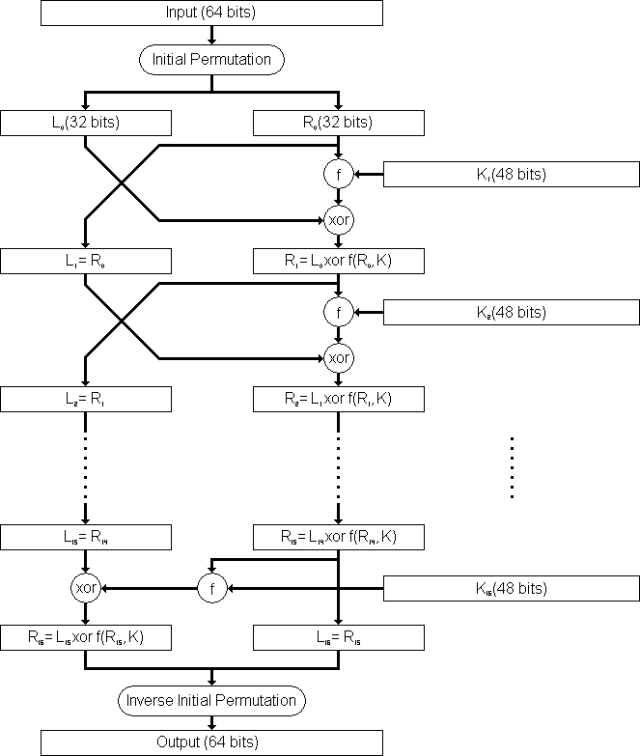
DES Algorithm/DES Structure/ Encryption of the DES (continued…):
Figure-1: Flow Diagram of DES algorithm for encrypting data.
Notes:
21

Slide 22
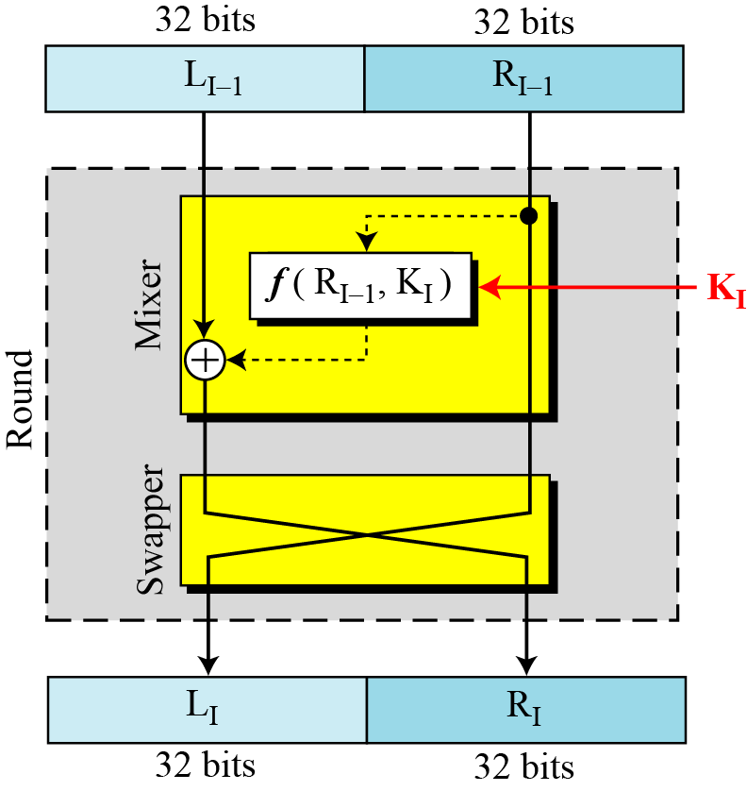
DES Rounds:
In DES, substitution and permutation are used a number of times in iterations called rounds. Generally, the more rounds there are, the more secure the algorithm is.
DES uses 16 rounds. Each round of DES is a Feistel cipher.
The round takes L_{i-1} and R_{i-1} from previous round (or the initial permutation box) and creates L_{i} and R_{i}, which go to the next round (or final permutation box).
Each round has two cipher elements: mixer and swapper. Each of these elements is invertible.
The swapper swaps the left half of the text with the right half. The mixer performs XOR operation.
Figure: A round in DES (encryption site)
Notes:
22

Slide 23
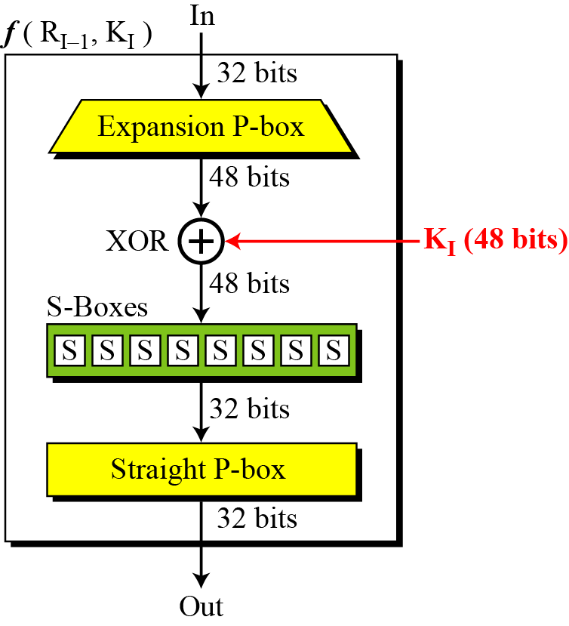
DES Round Function f(R_{i-1},K_{i}):
The heart of DES is DES round function.
The round function mixes the bits of the right (R) portion using the subkey for the current round.
It applies a 48-bit key to the rightmost 32 bits (R_{i-1}) to produce a 32-bit output.
All noninvertible elements in DES are collected inside the round function f(R_{i-1},K_{i})
This function is the main part of every round and consists of four sections:
1. An expansion P-box (E-box, for 32 bit to 48 bit conversion)
2. A whitener (Exclusive-or that adds key)
3. A group of S-boxes (for 48 bit to 32 bit conversion)
4. A straight permutation P-box
Figure: DES function
Notes:
23

Slide 24
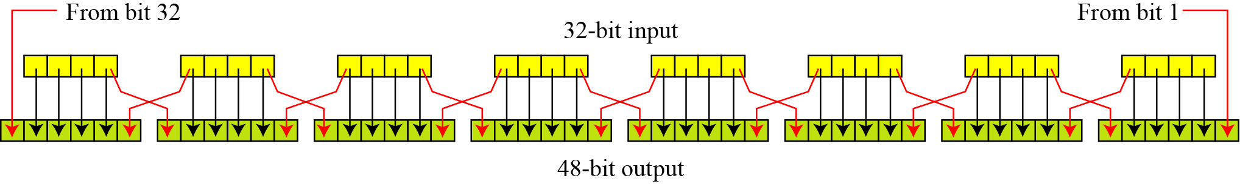
DES Round Function f(R_{i-1},K_{i}):
1. The E-box expansion permutation:
Since R_{i−1} is a 32-bit input and K_{i} is a 48-bit key, we first need to expand R_{i−1} to 48 bits.
To do this, the 32-bit R value is expanded to 48 bits using an expansion P-box permutation table E (shown in Table-1).
The expansion table defines a permutation plus an expansion.
Table-1: Expansion P-box table
Figure: Expansion permutation
Notes:
24

Slide 25
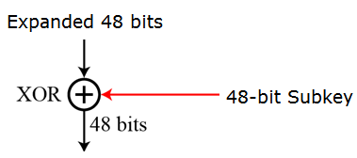
DES Round Function f(R_{i-1},K_{i}):
2. Whitener (Exclusive-or):
After the expansion permutation, DES uses the XOR operation on the expanded right section and the round key.
Note that both the right section and the key are 48-bits in length. Also note that the round key is used only in this operation.
That expanded value is then exclusive-or'ed with the 48-bit subkey.
Figure: Whitener
Notes:
25

Slide 26
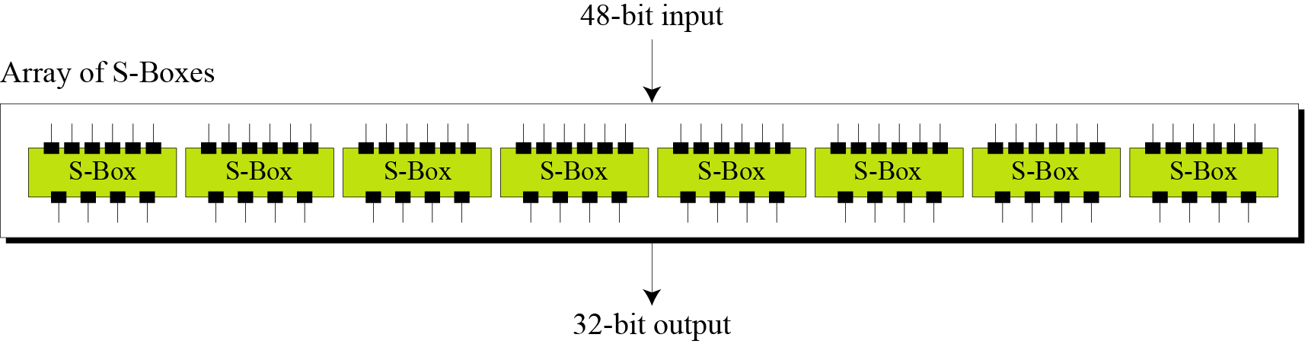
DES Round Function f(R_{i-1},K_{i}):
3. The S-boxes (substitute 48 bits to 32 bits):
In DES, a non-linearity is introduced into the encryption so that decryption will be computationally infeasible without the secret key. This is achieved with the use of S-boxes . which are basically non-linear substitution tables where either the output is smaller than the input or vice versa.
The S-boxes are the only non-linear operation in DES that do the real mixing (confusion).
DES uses 8 S-boxes, each with a 6-bit input and a 4-bit output, that is it accepts a 48-bit input and produces 32-bit number as output (defined in table-2).
The resulting 48 bits from whitener operation are divided into eight 6-bit chunks, each of which is fed into an S-Box that mixes the bits and produces a 4-bit output (The 8 S-boxes are shown in table-3). Those 4-bit outputs are combined into a 32-bit value.
The first and last bits of the 6-bit input of each S-box determine which column permutation is used. It provides non-linearity (confusion).
Figure: S-boxes
Notes:
26

Slide 27
DES Round Function f(R_{i-1},K_{i}):
4. Straight Permutation (P-box):
The combined 32 bits from the previous step are permuted once again to produce the 32 bits output of the f-function using expansion P-box table (Shown in Table-4).
Table-4: Straight permutation table
Notes:
27

Slide 28
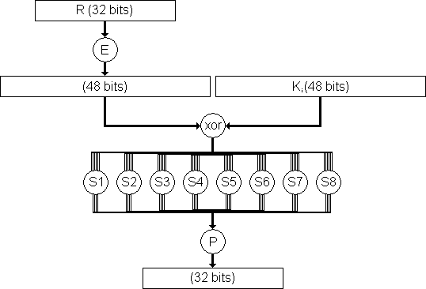
DES Round Function f(R_{i-1},K_{i}):
Figure below shows the DES round function f(x,k).
Figure-: The complex f(x,k) function of the DES algorithm.
Note:
The s-boxes provide the “confusion” of data and key values, whilst the permutation P then spreads this as widely as possible, so each S-box output affects as many S-box inputs in the next round as possible, giving “diffusion”.
Notes:
28

Slide 29
Modes of Operation in DES:
The DES algorithm is a basic building block for providing data security.
To apply DES in a variety of applications, five modes of operation have been defined which cover virtually all variation of use of the algorithm and these are shown in table-8 below.
Table-8: Modes of operation in DES
Notes:
29

Slide 30
RSA Cryptosystem
RSA is the most commonly used public-key cryptography algorithm, which uses prime factorization as the trapdoor one-way function. That is, it is based on the presumed difficulty of factoring large integers.
It is named so after the surnames of its inventors Ron Rivest, Adi Shamir, and Leonard Adleman of the Massachusetts Institute of Technology (MIT).
It was first published in 1978.
This algorithm relies on one way function. A one way function is easy to compute but hard to invert. For example it is easy to take the product of two prime numbers but given the product, it is difficult to split it into the original prime factors.
This algorithm lets you choose the size of your public key.
The 512-bit keys are considered insecure or weak, but the 768-bit keys are secure from everything but the National Security Administration (NSA).
The 1024-bit keys are secure from everything virtually.
RSA is embedded in major products such as Windows, Netscape Navigator etc.
Notes:
30

Slide 31
How the RSA Cryptosystem Works?
Briefly, the RSA algorithm involves multiplying two large prime numbers P and Q and through additional operations deriving a set of two numbers e and d where e is the public key and d is the private key.
Once the keys have been developed, the original prime numbers are no longer important and can be discarded. Both the public and the private keys are needed for encryption /decryption but only the owner of a private key ever needs to know it. Using the RSA system, the private key never needs to be sent across the Internet.
Anyone can use the public key to encrypt a message. But the message can be decrypted only by the owner of the private key.
Thus, if Alice wants to send a message to Bob, she can find out Bob’s public key (but not his private key) from a central administrator.
After getting the public key of Bob, Alice then encrypt the message using Bob’s public key and sends the encrypted message to Bob.
When Bob receives it, he decrypts it with his private key.
In addition to encrypting messages (which ensures privacy), Bob can authenticate himself to Alice (so Alice knows that it is really Bob who sent the message) by using Bob’s private key to encrypt a digital certificate. When Alice receives it, she can use Bob’s public key to decrypt it.
Notes:
31

Slide 32
Steps in RSA Algorithm
The RSA algorithm involves three steps:
Key generation (Generating public and private key)
Encryption (Encrypting the message)
Decryption (Decrypting the message)
RSA involves a public key and a private key.
The public key can be known by everyone and is used for encrypting messages.
Messages encrypted with the public key can only be decrypted in a reasonable amount of time using the private key.
Notes:
32

Slide 33
RSA Algorithm: Key Generation
The keys for the RSA algorithm are generated by the following ways:
Choose two large and distinct prime numbers p and q.
For security purposes, the integers p and q should be chosen at random, and should be of similar bit-length.
In RSA, p and q must be at least 512 bits; n must be at least 1024 bits.
Prime integers can be efficiently found using a primality test.
Compute n = p * q
n is used as the modulus for both the public and private keys. Its length, usually expressed in bits, is the key length.
Compute the number of integers less than n that are coprime with n (otherwise known as the totient or Euler’s Phi function):
φ(n) = φ(p*q) = φ(p)* φ(q)=(p - 1) * (q – 1)
Choose an integer e such that 1 < e < φ(n) and gcd(e, φ(n)) = 1; i.e. e and φ(n) are coprime.
e is released as the public key exponent (encryption exponent).
e having a short bit-length results in more efficient encryption– most commonly 2¹⁶ + 1 = 65,537. However, much smaller values of e (such as 3) have been shown to be less secure in some settings.
Notes:
33

Slide 34
RSA Algorithm: Key Generation
Determine the multiplicative inverse d of e; i.e., compute a value for d such that it satisfies the relation: (d * e) mod φ(n) = 1
d is kept as the private key exponent (decryption exponent).
d is often computed using the Extended Euclidean Algorithm.
d must be kept secret.
p, q, and φ(n) must also be kept secret because they can be used to calculate d.
The public key consists of the modulus n and the public key exponent e; i.e., the public key is (e, n).
The private key consists of the modulus n and the private key exponent d; i.e., the private key is (d, n).
To encrypt message m using the public key, use the relation:
c = m^{e} mod n
To decrypt c using the private key, use the relation:
m = c^{d} mod n
Notes:
34

Slide 35
RSA Algorithm: Encryption
Bob transmits his public key (e, n) to Alice and keeps the private key (d, n) secret.
Alice then wishes to send message M to Bob.
The message is encrypted by the following ways:
Alice first turns message M into an integer m, such that 0 ≤ m < n.
That is, the message is represented as an integer between 0 and (n-1).
Large messages can be broken up into a number of blocks. Each block would then be represented by an integer in the same range.
After turning the message into integer, Alice then computes the ciphertext c using the following relation:
c = m^{e} mod n
After computing ciphertext, Alice then transmits c to Bob.
Notes:
35

Slide 36
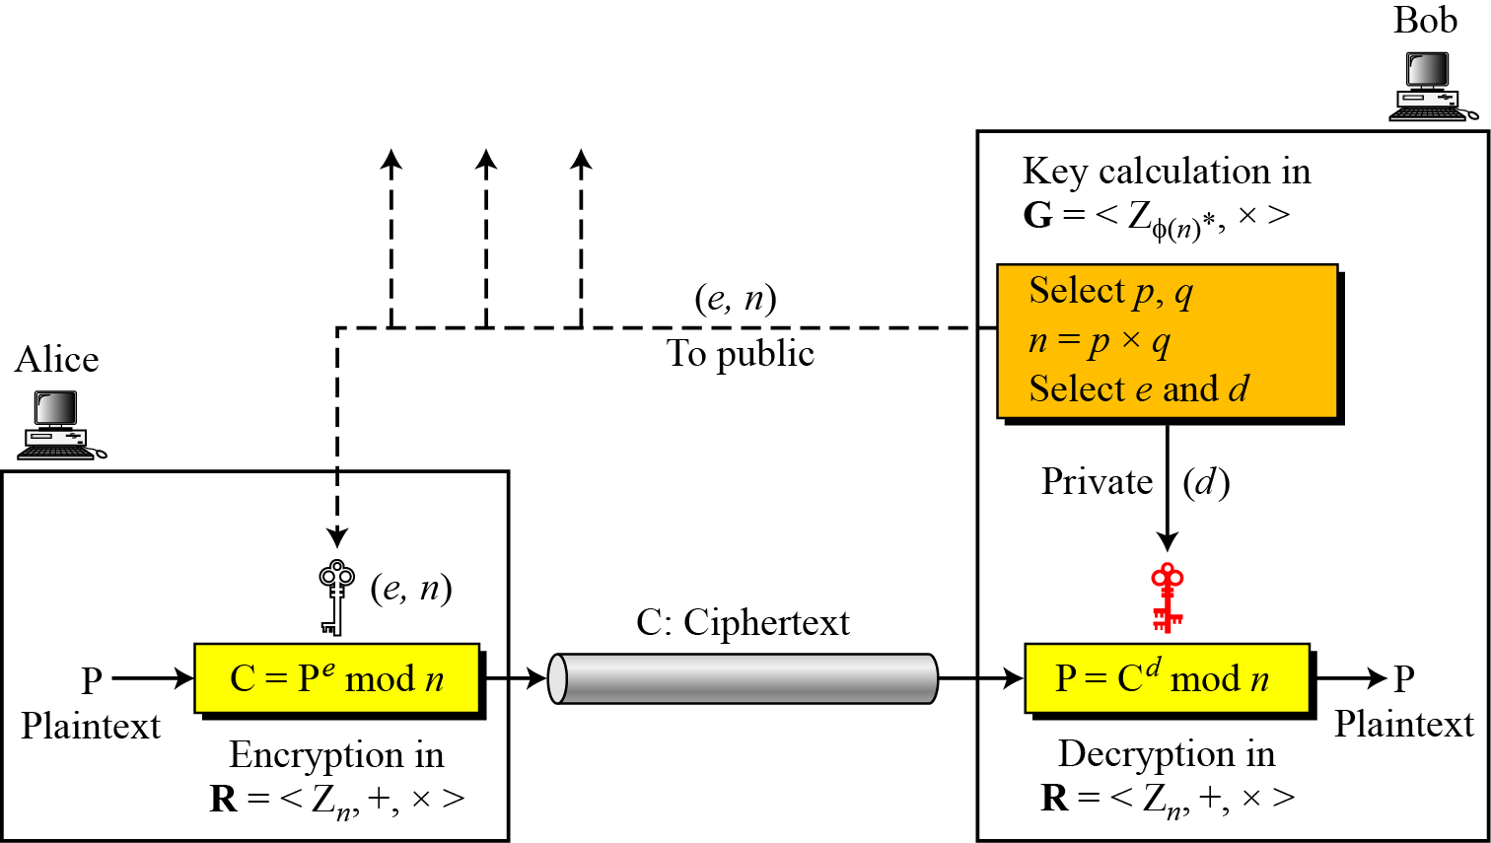
RSA Algorithm: Decryption
Bob can recover m from c by using his private key exponent d using the following relation:
m = c^{d} mod n
After having m, Bob can recover the original message M by reversing the padding scheme.
The encryption, decryption and key generation in RSA
is shown in the figure below.
Figure: Encryption, decryption, and key generation in RSA
Notes:
36

Slide 37
RSA Cryptosystem: Trivial Examples
Example-1:
Choose p = 3 and q = 11
Compute n = p * q = 3 * 11 = 33
Compute φ(n) = φ(p*q) = φ(p)* φ(q)=(p - 1) * (q - 1) = 2 * 10 = 20
Choose e such that 1 < e < φ(n) and e and φ(n) are coprime. We have several choices for e: 7, 11, 13, 17, 19. (We cannot use 5 as e, because 20 is divisible by 5). Let e = 7
Compute a value for d such that (d * e) mod φ(n) = 1. One solution is d = 3 [(3 * 7) % 20 = 1] [d is the multiplicative inverse of e]
Public key is (e, n) => (7, 33)
Private key is (d, n) => (3, 33)
The encryption of m = 2 is c = m^{e} mod n = 2⁷ mod 33 = 29
The decryption of c = 29 is m = c^{d} mod n = 29³ mod 33 = 2
Notes:
37

Slide 38
RSA Cryptosystem: Trivial Examples
Example-2:
Bob chooses 7 and 11 as p and q.
He calculates n = 77. The value of φ(n) = (7 − 1)(11 − 1) or 60.
Now he chooses two exponents, e and d, from Z₆₀∗. If he chooses e to be 13, then d is 37. Note that e × d mod 60 = 1 (they are inverses of each).
Now imagine that Alice wants to send the plaintext 5 to Bob. She uses the public exponent 13 to encrypt 5.
Bob receives the ciphertext 26 and uses the private key 37 to decipher the ciphertext:

Slide 39
RSA Cryptosystem: Trivial Examples
Example-3:
Now assume that another person, John, wants to send a message to Bob.
John can use the same public key announced by Bob (probably on his website), 13.
John’s plaintext is 63. John calculates the following:
Bob receives the ciphertext 28 and uses his private key 37 to decipher the ciphertext:

Slide 40
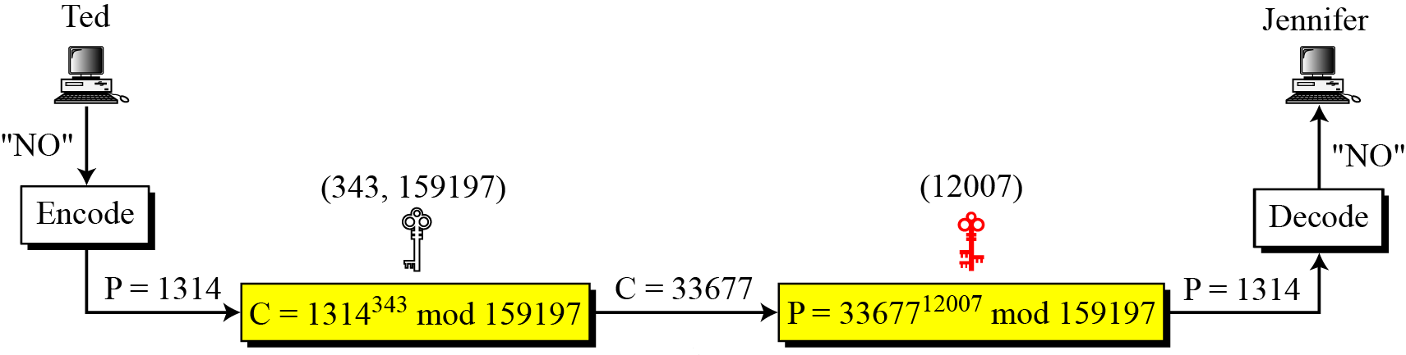
RSA Cryptosystem: Trivial Examples
Example-4:
Jennifer creates a pair of keys for herself. She chooses p = 397 and q = 401.
She calculates n = 159197. She then calculates φ(n) = 158400. She then chooses e = 343 and d = 12007.
Show how Ted can send a message to Jennifer if he knows e and n.
Solution:
Suppose Ted wants to send the message “NO” to Jennifer.
He changes each character to a number (from 00 to 25), with each character coded as two digits.
He then concatenates the two coded characters and gets a four-digit number. The plaintext is 1314.
He then uses e and n to encrypt the message.
Figure below shows the process.

Slide 41
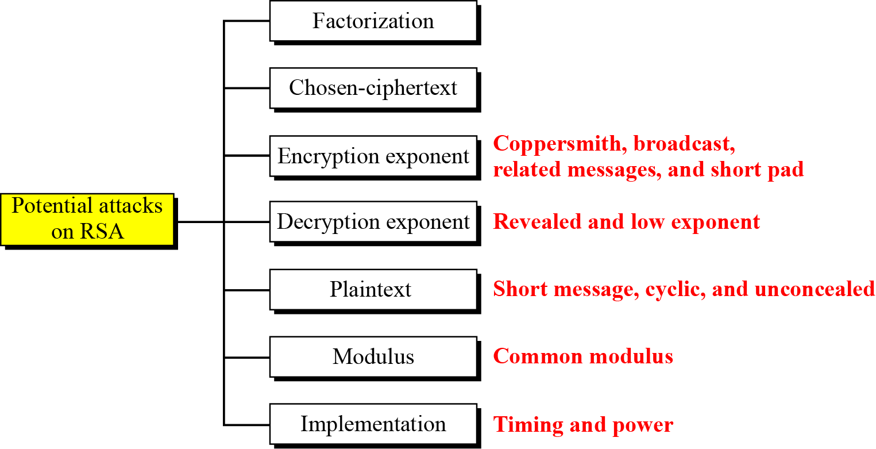
Attacks on RSA Cryptosystem
No devastating attacks on RSA have been yet discovered.
Several attacks have been predicted based on the weak plaintext, weak parameter selection, or inappropriate implementation.
Figure below shows the category of potential attacks on RSA.
Figure: Taxonomy of potential attacks on RSA

Slide 42
RSA Cryptosystem: Cracking the Code
The essential requirement of the Public Key Cryptography, like RSA, is that-the public and secret keys are mathematically related, but this relationship must be made very hard to determine by an outsider.
As we saw in the preceding text, everything starts with p and q, from which we calculated n.
The public key consists of two numbers: e and n, where e is calculated from φ(n), and φ(n) is calculated from p and q.
The secret key d, was calculated from e and φ(n) and, as we just stated, e and φ(n) are calculated from p and q.
It follows then, that d is also calculated from p and q, which proves that the public and private keys are mathematically related.
So, if an adversary (like Eve) wanted to find the secret key d, by only knowing n, he must break down n into the two prime numbers that were used to produce it (remember that n = p * q).
Now, here is the real crux of the bisquit: Decomposing a very large n into p and q is really difficult to do. It is easy with the small numbers that we have used in our demonstration, but, for example, if 100 digit numbers are used for p and q, the resulting n will be approximately 200 digits. Then decomposing n into p and q will be very hard. The fastest known factoring algorithm would take far too long for an attacker to ever break the code.
Well, if you have some free time on your hands, try this challenge: n=13289. Find p and q. If you can find, you may even earn some money.
Any cryptographic technique which can resist a concerted attack is regarded as secure. At this point in time, the RSA algorithm is considered secure.
Notes:
42

Slide 43
RSA Cryptosystem
In RSA cryptosystem, encryption using public keys is normally computationally intensive. So, in practice-
The sender encrypts the message with a secret key that is randomly generated.
The secret key is encrypted using the public key of the recipient and sent with the encrypted message.
The recipient decrypts the secret key using his private key and using that secret key, he decrypts the rest of the message.
The following lists all the steps in the process:
The client and server go through a handshaking procedure.
The handshake begins when the client connects to a SSL enabled server requesting a secure connection and presents a list of encryption algorithms and hash functions that it supports.
From this list the server chooses the most secure encryption algorithm and hash function that it also supports and lets the client know about its choice.
In the above transaction, the server also sends it identification in the form of a digital certificate. The digital certificate contains the server's name, the trusted Certificate Authority, and the server's public encryption key.
The client may contact the trusted Certificate Authority for verification.
The client generates a random number and encrypts it with the server's public key and sends it to the server. Only the server can decrypt this with its private key.
The random number generated by the client is then used in the encryption and decryption process on both the client and server sides.
Notes:
43

Slide 44
RSA Cryptosystem: Applications
Although RSA can be used to encrypt and decrypt actual messages, it is very slow if the message is long.
Therefore, RSA is useful for short messages.
RSA is used in digital signature and other cryptosystems that often need to encrypt a small message without having access to a symmetric key.
RSA is also used for authentication.
Notes:
44

Slide 45
Rabin Cryptosystem
The Rabin cryptosystem (published in January 1979 by Michael O. Rabin) is an asymmetric cryptographic technique, whose security, like that of RSA, is related to the difficulty of factorization.
This cryptosystem is a variation of the RSA cryptosystem:
RSA is based on the exponentiation congruence;
Rabin is based on the quadratic congruence;
The Rabin cryptosystem can be thought of as an RSA cryptosystem in which the value of e and d are fixed, i.e., e=2 and d=1/2. This means, in Rabin cryptosystem, the formula for encryption is C≡P² mod n and the formula for decryption is P ≡ C^{1/2} mod n.
The public key in the Rabin cryptosystem is n and the private key is (p,q). Everyone can encrypt a message using n; only Bob can decrypt the message using p and q.
Decryption of the message is infeasible for Eve because she does not know the values of p and q.
Notes:
45

Slide 46
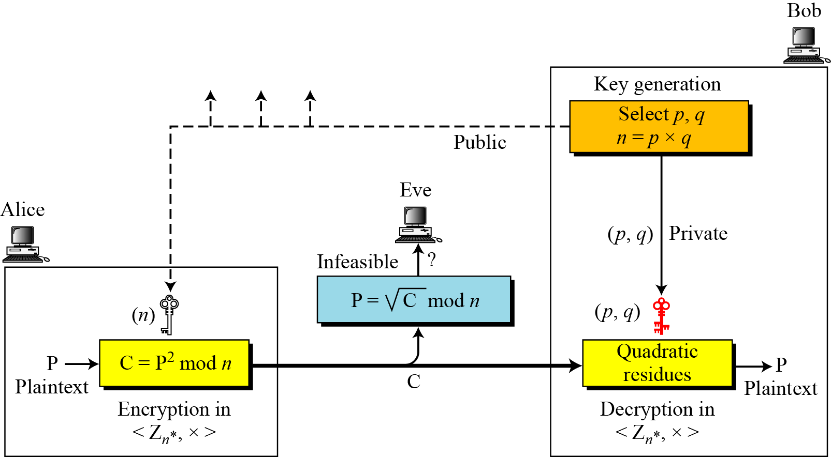
Rabin Cryptosystem
In Rabin cryptosystem, Bob chooses two large and distinct prime numbers p and q such that p ≡ q ≡ 3 (mod4) and then he calculates n=p x q. He announces n as the public key and keeps (p, q) to him as the private key.
Anyone (say Alice) can encrypt a message using the public key based on the formula: C≡P² mod n and can send the encrypted message to Bob.
Using the private key, Bob alone can decrypt the message.
The process is shown in the figure below.
Figure: Rabin cryptosystem

Slide 47
Rabin Algorithm: Key Generation
As with all asymmetric cryptosystems, the Rabin system uses both a public and a private key.
The public key is necessary for encryption and can be published.
The private key must be possessed only by the recipient of the message.
The precise key-generation process for Rabin cryptosystem is as follows:
Choose two large distinct primes p and q.
One may choose p and q such that p ≡ q ≡ 3 (mod4) to simplify the computation of square roots modulo p and q. But the scheme works with any primes.
Compute n = p * q. Then n is the public key. The primes p and q are the private key.
To encrypt a message, only the public key n is needed.
To decrypt a ciphertext, the factors p and q of n are necessary.
As a trivial example, if p = 7 and q = 11, then n=77. The public key 77 would be released, and the message is encoded using this key. In order to decode the message, the private keys 7 and 11 would have to be known.
Notes:
47

Slide 48
Rabin Algorithm: Encryption
Anyone can send a message to Bob using his public key n.
The encryption process is listed below:
Represent the message as an integer in the range {0,……, n-1}.
Now the ciphertext c is determined by
c = m² mod n
That is, c is the quadratic remainder of the square of the plaintext, modulo the key-number n.
Note:
In Rabin cryptosystem, encryption is very simple. The operation needs only one multiplication, which can be done quickly. This is beneficial when resources are limited. For example, smart cards have limited memory and need to use short CPU time.
As a trivial example, let p = 7 and q = 11, then n=77 is the public key which will be used to encrypt the message.
In our simple example, P = { 0, 2, …., 76} is our plaintext space. We will take m = 20 as our plaintext. The ciphertext is thus c = m² mod n = 20² mod 77 = 400 mod 77= 15.
For exactly four different values of m, the ciphertext 15 is produced, i.e. for m in { 13, 20, 57, 64 }. This is true for most ciphertexts produced by the Rabin algorithm, i.e. it is a four-to-one function.
Notes:
48

Slide 49
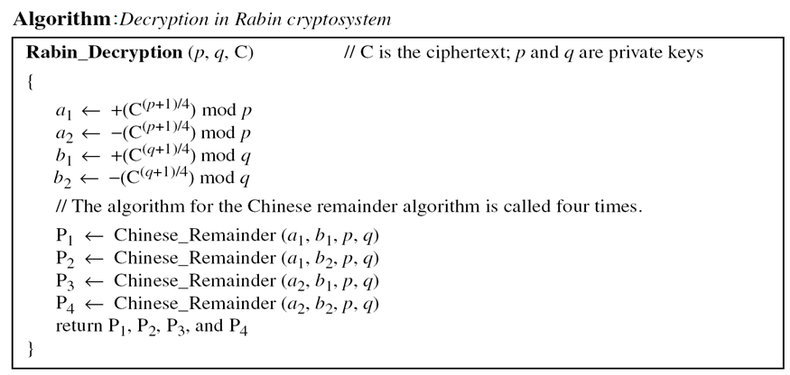
Rabin Algorithm: Decryption
To decrypt the ciphertext, the private keys are necessary.
Decryption is based on the solution of quadratic congruence.
Because the received ciphertext is the square of the plaintext, it is guaranteed that C has roots (quadratic residues) in Z_{n}*. The Chinese remainder algorithm is used to find four square roots.
Rabin cryptosystem is not deterministic: decrypting a message can produce four different plaintext outputs, of which only one is the correct plaintext. It is up to the receiver of the message to choose one of these four as final answer.
The decryption is performed by the following algorithm:

Slide 50
Rabin Algorithm: Trivial Example
Here is a very trivial example to show the idea.
Bob selects p = 23 and q = 7. Note that both are congruent to 3 mod 4 (i.e. 23 mod 4 =3 and 7 mod 4=3).
Bob calculates n = p × q = 161.
Bob announces n publicly; he keeps p and q private.
Alice wants to send the plaintext P = 24. Note that 161 and 24 are relatively prime; 24 is in Z₁₆₁*. She calculates C = 24² = 93 mod 161, and sends the ciphertext 93 to Bob.
Bob receives 93 and calculates four values: a₁ = +(93 ^{(23+1)/4}) mod 23 = 1 mod 23 a₂ = −(93 ^{(23+1)/4}) mod 23 = 22 mod 23 b₁ = +(93 ^{(7+1)/4}) mod 7 = 4 mod 7 b₂ = −(93 ^{(7+1)/4}) mod 7 = 3 mod 7
Bob takes four possible answers, (a₁, b₁), (a₁, b₂), (a₂, b₁), and (a₂, b₂), and uses the Chinese remainder theorem to find four possible plaintexts: 116, 24, 137, and 45. Note that only the second answer is Alice’s plaintext.

Slide 51
Evaluation of Rabin Algorithm
Effectiveness:
In Rabin cryptosystem, decoding produces three false results in addition to the correct one, so that the correct result must be guessed. This is the major disadvantage of the Rabin cryptosystem and one of the factors which have prevented it from finding widespread practical use.
If the plaintext is intended to represent a text message, guessing is not difficult; however, if the plaintext is intended to represent a numerical value, this issue becomes a problem that must be resolved by some kind of disambiguation scheme. It is possible to choose plaintexts with special structures, or to add padding, to eliminate this problem.
A way of removing the ambiguity of inversion was suggested by Blum and Williams:
the two primes used are restricted to primes congruent to 3 modulo 4 and the domain of the squaring is restricted to the set of quadratic residues. These restrictions make the squaring function into a trapdoor permutation, eliminating the ambiguity.
Notes:
51

Slide 52
Evaluation of Rabin Algorithm
Security:
The Rabin cryptosystem is computationally secure against a chosen plaintext attack provided that the modulus n can not be factored. That is, if p and q are very large, then Rabin system is as secure as RSA.
The great advantage of the Rabin cryptosystem is that a random plaintext can be recovered entirely from the ciphertext only if the codebreaker is capable of efficiently factoring the public key n. Note that this is a very weak level of security. Extensions of the Rabin cryptosystem achieve stronger notions of security.
It has been proven that decoding the Rabin cryptosystem is equivalent to the integer factorization problem, which is rather different than for RSA. Thus the Rabin system is 'more secure' in this sense than is RSA, and will remain so until a general solution for the factorization problem is discovered, or until the RSA problem is discovered to be equivalent to factorization. (This assumes that the plaintext was not created with a specific structure to ease decoding.)
Notes:
52

Slide 53
RSA Vs. Rabin Cryptosystems
Both the RSA and the Rabin cryptosystems are asymmetric cryptographic techniques.
Rabin cryptosystem is a variation of the RSA cryptosystem:
RSA is based on the exponentiation congruence;
Rabin is based on the quadratic congruence;
The Rabin cryptosystem can be thought of as an RSA cryptosystem in which the value of e and d are fixed, i.e., e=2 and d=1/2. This means, in Rabin cryptosystem, the formula for encryption is C≡P² mod n and the formula for decryption is P ≡ C^{1/2} mod n.
The public key in the Rabin cryptosystem is n and the private key is (p,q). But in RSA, the public key is (e,n) and private key is d.
If Bob is using RSA, he can keep d and n; and discard vp, q, and φ(n) after key generation. But, if Bob is using Rabin cryptosystem, he needs to keep p and q.
Notes:
53

Slide 54
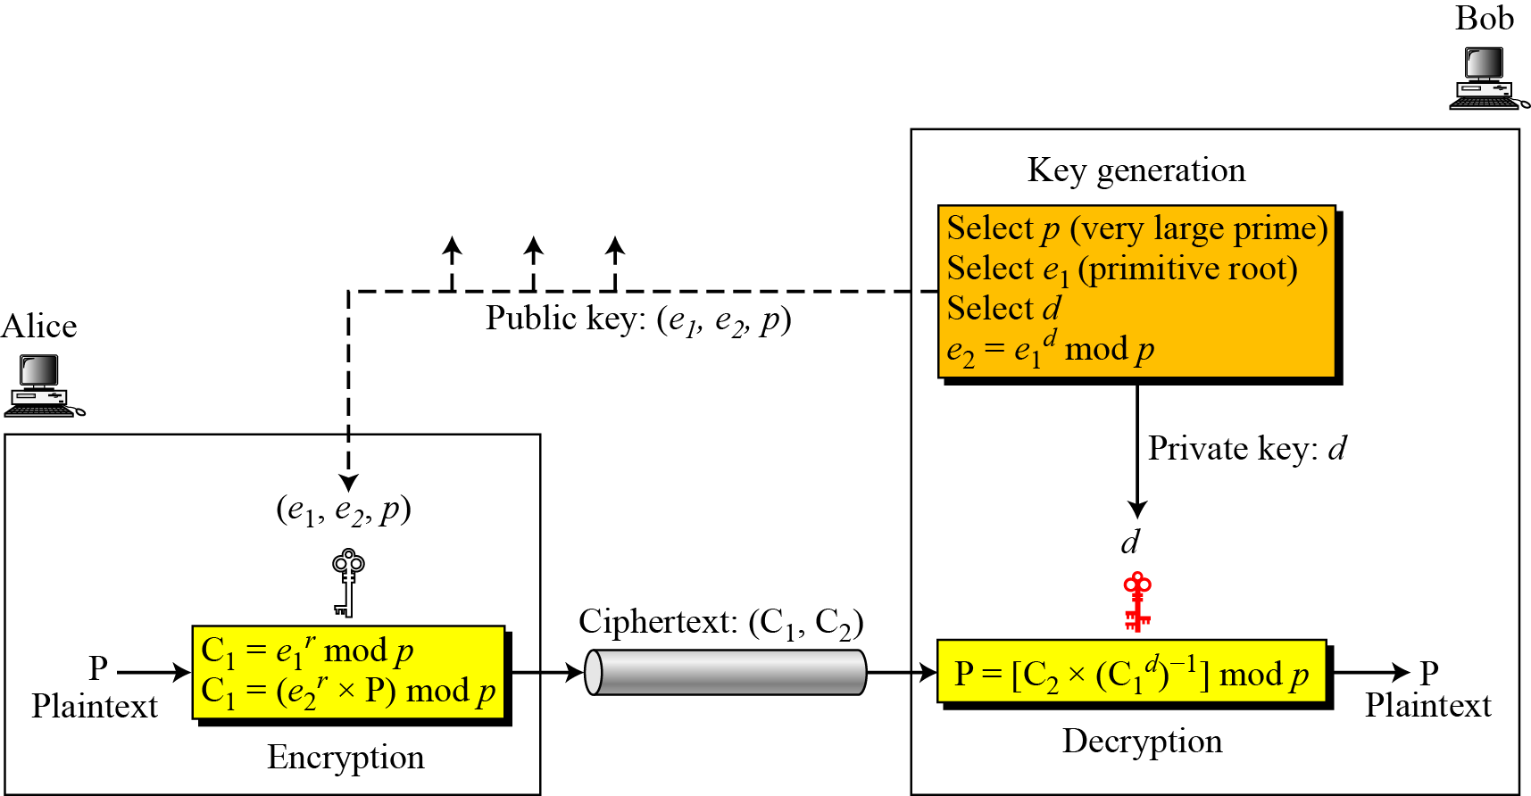
ElGamal Cryptosystems
Besides RSA and Rabin, another public-key cryptosystem is ElGamal, named after its inventor Taher ElGamal.
This cryptosystem is based on the discrete logarithm problem.
Figure below shows the key generation, encryption, and decryption in ElGamal cryptosystem.
Figure: Key generation, encryption, and decryption in ElGamal
Notes:
54

Slide 55
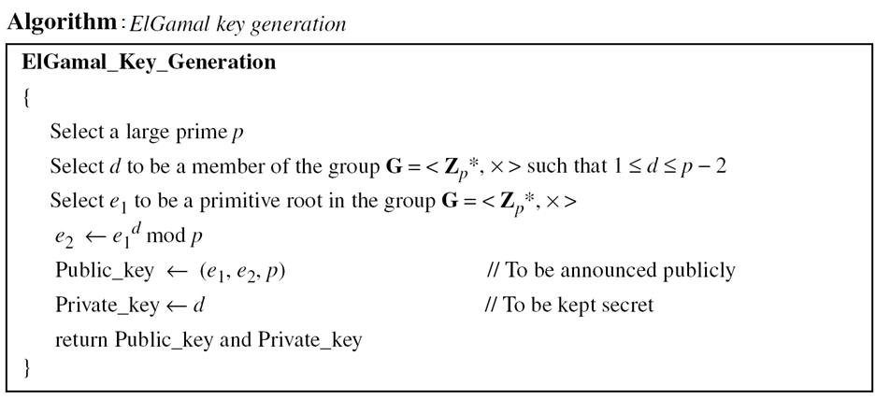
ElGamal Cryptosystems: Key Generation
Bob uses the steps shown in the algorithm below to create his public and private keys.

Slide 56
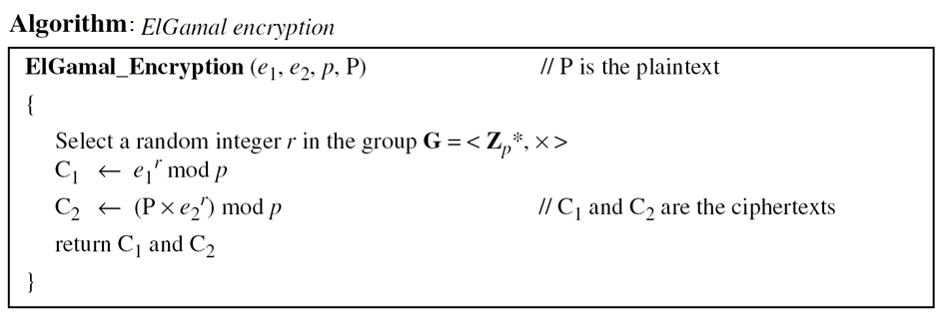
ElGamal Cryptosystems: Encryption
Anyone can send a message to Bob using his public key.
The encryption process is shown in the algorithm below.

Slide 57
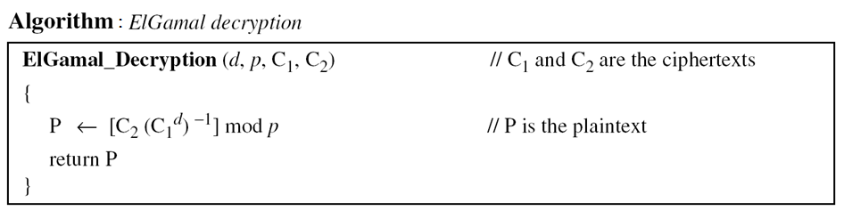
ElGamal Cryptosystems: Decryption
Bob can use the following algorithm to decrypt the ciphertext message he received.

Slide 58
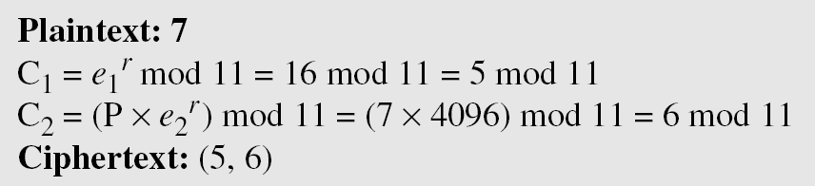
ElGamal Cryptosystems: Trivial Example
Here is a trivial example.
Bob chooses p = 11 and e₁ = 2. Note that 2 is a primitive root in Z₁₁*.
Bob then chooses d = 3 and calculate e₂ = e₁^{d} = 8.
So the public keys are (2, 8, 11) and the private key is 3.
Alice chooses r = 4 and calculates C₁ and C₂ for the plaintext 7.
Bob receives the ciphertexts (5 and 6) and calculates the plaintext.

Slide 59
ElGamal Cryptosystems: Trivial Example
Instead of using P = [C₂ × (C₁^{d}) ⁻¹] mod p for decryption, we can avoid the calculation of multiplicative inverse and use
P = [C₂ × C₁ ^{p−1−d}] mod p.
In the previous example, we can calculate
P = [6 × 5 ¹¹⁻¹⁻³] mod 11= 7 mod 11.
For the ElGamal cryptosystem, p must be at least 300 digits and r must be new for each encipherment.

Slide 60
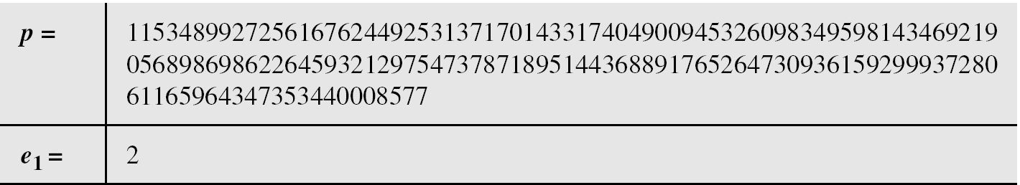
ElGamal Cryptosystems: Realistic Example
Bob uses a random integer of 512 bits (the ideal is 1024 bits).
The integer p is a 155-digit number (the ideal is 300 digits).
Bob then chooses e₁, d, and calculates e₂, as shown below:
Bob announces (e₁, e₂, p) as his public key and keeps d as his private key.

Slide 61
ElGamal Cryptosystems: Trivial Example
Alice has the plaintext P = 3200 to send to Bob.
She chooses r = 545131, calculates C₁ and C₂, and sends them to Bob.
Bob calculates the plaintext P = C₂ × ((C₁)^{d})⁻¹ mod p = 3200 mod p.

Slide 62
ElGamal Cryptosystems: Application
ElGamal can be used whenever RSA can be used.
It is used for key exchange, authentication, and encryption and decryption of small messages.

